Slide 1

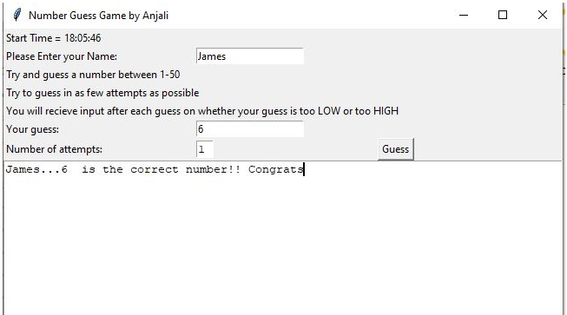
Today is your Day!!! Try Your luck!!!
Coder: Anjali Bala
Original Coder: https://github.com/ksu-is/Simple-Number-Guessing-Game

